Slide 1
Static electricity
EP0605
pre-class (1 to 14)
In-class (16 onwardS)

Slide 2
Learning objectives
State Coulomb’s law for forces between point charges.
Perform calculations on electric force due to several point charges.
Perform calculations on electric field at a point due to several point charges.

Slide 3
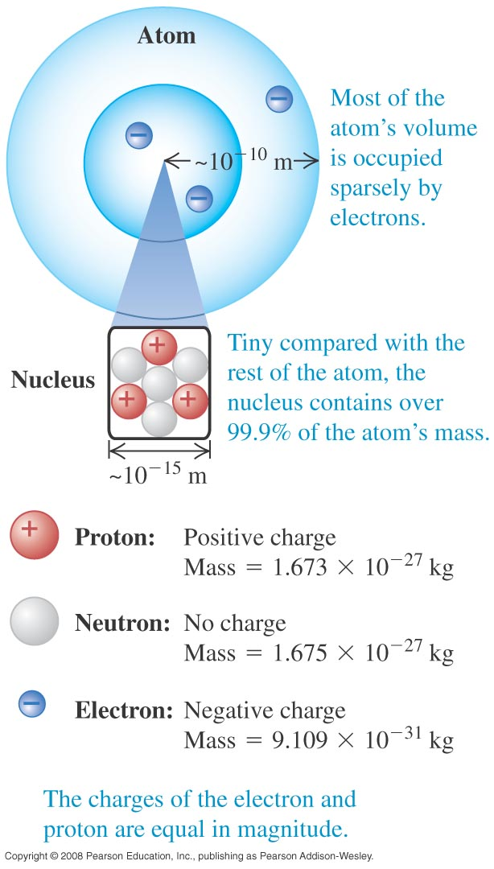

Atoms
Atoms are made up of :
electrons
protons
neutrons
The number of protons and electrons are equal when the atom is neutral.
An electron has a charge of $−$1.6 × 10⁻¹⁹ C.
A proton has a charge of +1.6 × 10⁻¹⁹ C.

Slide 4
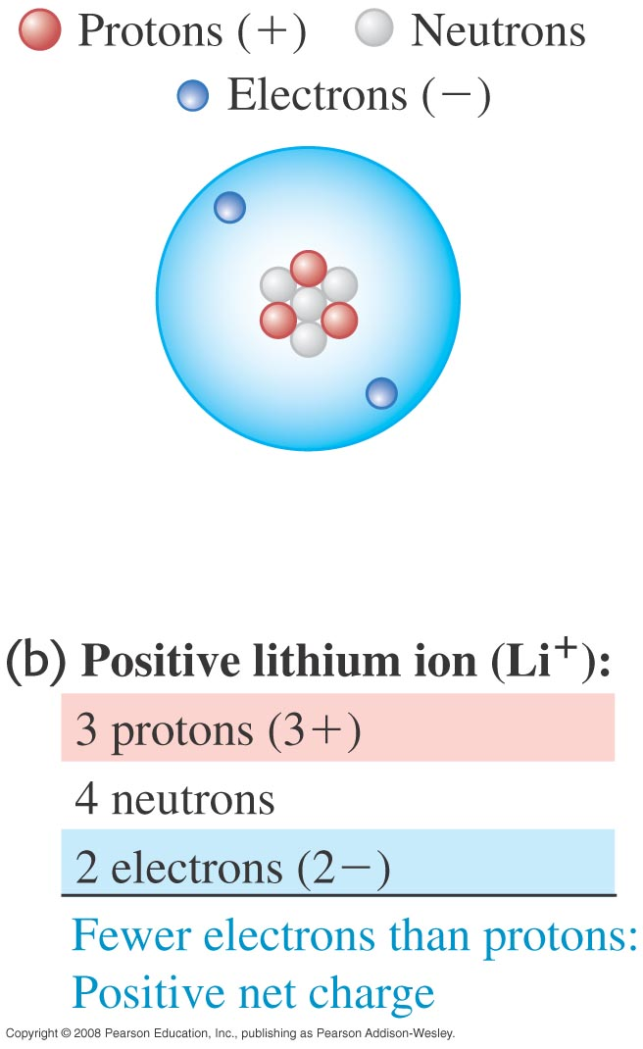
Ions
A lithium atom gas 3 protons and 3 electrons.
A positive lithium ion has 3 protons and 2 electrons and a net charge of +1.6 × 10⁻¹⁹ C.
A negative lithium ion has 3 protons and 4 electrons and a net charge of –1.6 × 10⁻¹⁹ C
Transfer of electrons between the atoms of objects can result in the objects either acquiring a net positive or negative charge.

Slide 5

Example 1
How many electrons will give you a charge of –32×10⁻⁶ C?
Solution:
Number of electrons:
$$n=\frac{Q}{e}=\frac{−32×{10}^{−6}}{−1.6×{10}^{−19}}=2.0×{10}^{14}$$
Notes:
n = 2 × 10¹⁴

Slide 6
Example 2
If you transfer 10⁶ electrons from object A to object B, what is their net charge? Charge of an electron is –1.6 × 10⁻¹⁹ C.
Amount of charge transferred is
Hence A becomes +1.6 × 10⁻¹³ C and B becomes –1.6 × 10 ⁻¹³ C.

Slide 7
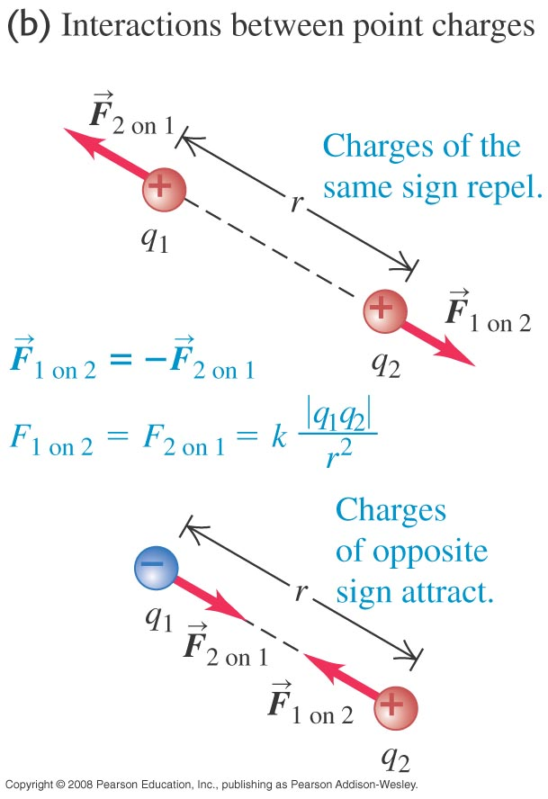
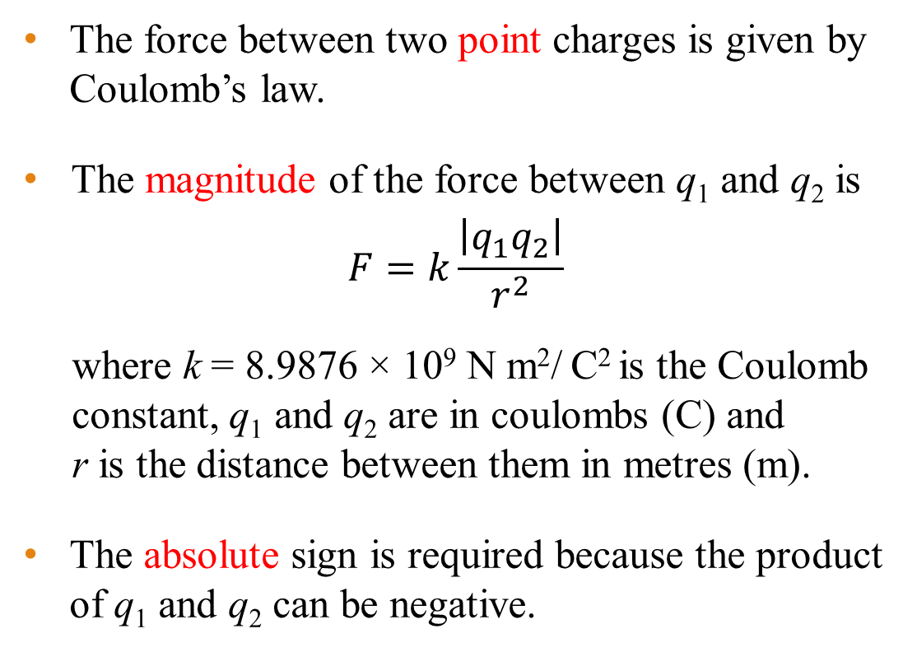
Coulomb’s Law for point charges
The force between two point charges is given by Coulomb’s law.
The magnitude of the force between q₁ and q₂ is
$$F=k\frac{\left|q_{1}q_{2}\right|}{r^{2}}$$
where k = 8.9876 × 10⁹ N m²/ C² is the Coulomb constant, q₁ and q₂ are in coulombs (C) and r is the distance between them in metres (m).
The absolute sign is required because the product of q₁ and q₂ can be negative.

Slide 8
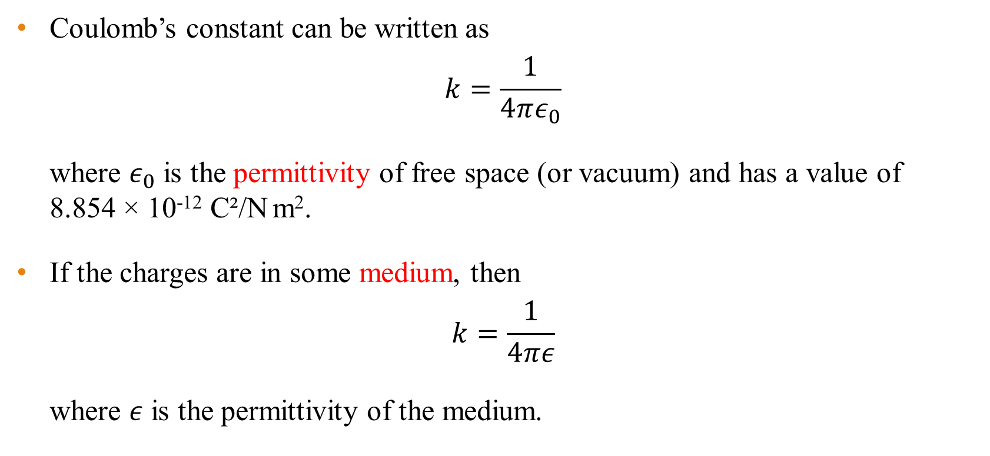
Permittivity
Coulomb’s constant can be written as
$$k=\frac{1}{4πε_{0}}$$
where $ε_{0}$ is the permittivity of free space (or vacuum) and has a value of 8.854 × 10⁻¹² C²/N m².
If the charges are in some medium, then
$$k=\frac{1}{4πε}$$
where $ε$ is the permittivity of the medium.

Slide 9
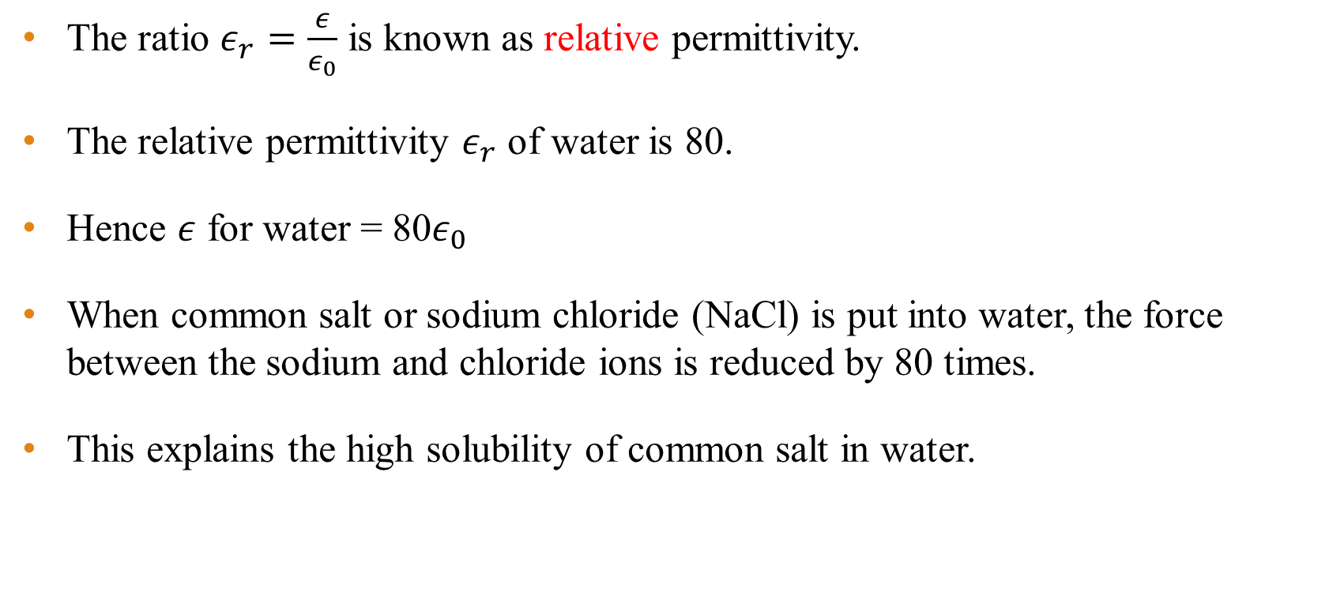
Relative permittivity
The ratio $ε_{r}=\frac{ε}{ε_{0}}$ is known as relative permittivity.
The relative permittivity $ε_{r}$ of water is 80.
Hence $ε$ for water = 80$ε_{0}$
When common salt or sodium chloride (NaCl) is put into water, the force between the sodium and chloride ions is reduced by 80 times.
This explains the high solubility of common salt in water.

Slide 10





Superposition of forces
The superposition of forces principle states that the resultant force on any one charge equals the vector sum of all the forces exerted by the other individual charges that are present, i.e.,
$$\vec{F}={\vec{F}}_{1}+{\vec{F}}_{2}+{\vec{F}}_{3}+…$$
q₁
+
$${\vec{F}}_{1}$$
$${\vec{F}}_{2}$$
-
q₂
+
$${\vec{F}}_{3}$$
q
$$\vec{F}$$
-
q₃

Slide 11
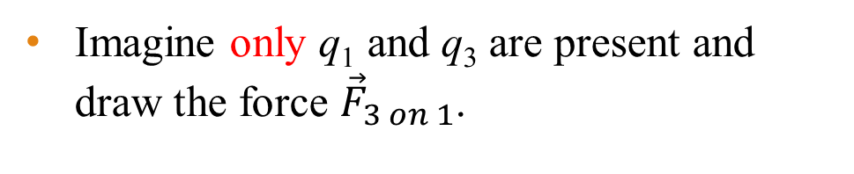
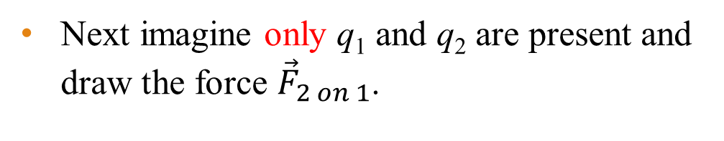


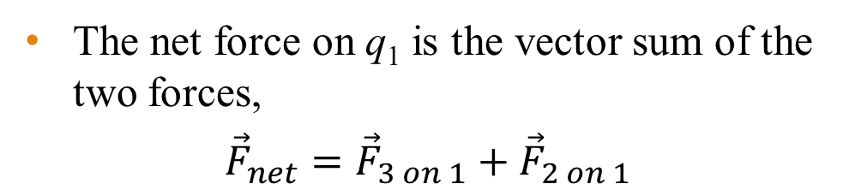

Force on point charge due to other point charges
Consider the three charges shown.
Suppose we want the force on q₁ due to q₂ and q₃.
q₁
q₂
q₃
+
-
+
q₁
-
q₃
$${\vec{F}}_{3 on 1}$$
Imagine only q₁ and q₃ are present and draw the force ${\vec{F}}_{3 on 1}$.
+
+
q₁
q₂
Next imagine only q₁ and q₂ are present and draw the force ${\vec{F}}_{2 on 1}$.
+
-
$${\vec{F}}_{3 on 1}$$
q₁
$${\vec{F}}_{2 on 1}$$
The net force on q₁ is the vector sum of the two forces,
$${\vec{F}}_{net}={\vec{F}}_{3 on 1}+{\vec{F}}_{2 on 1}$$
+

Slide 12
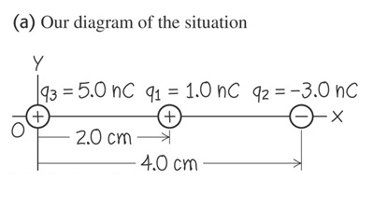
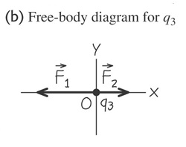
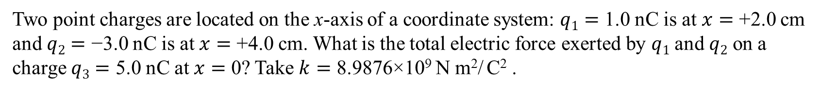
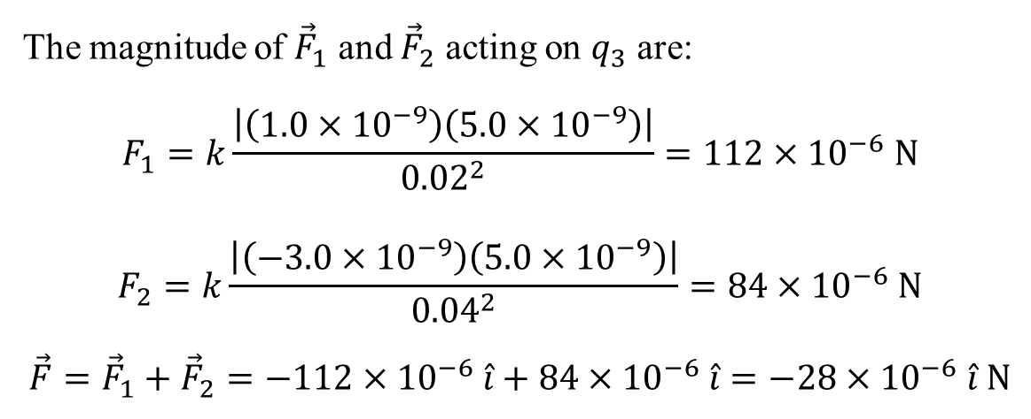
Example 3
Two point charges are located on the x-axis of a coordinate system: $q1=$ 1.0 nC is at $x=$ +2.0 cm and $q2=$ −3.0 nC is at $x=$ +4.0 cm. What is the total electric force exerted by $q1$ and $q2$ on a charge $q3=$ 5.0 nC at $x=$ 0? Take $k=$ 8.9876×10⁹ N m²/ C² .
The magnitude of ${\vec{F}}_{1}$ and ${\vec{F}}_{2}$ acting on $q_{3}$ are:
$$F_{1}=k\frac{\left|\left(1.0×{10}^{−9}\right)\left(5.0×{10}^{−9}\right)\right|}{{0.02}^{2}}=112×{10}^{−6} \text{N}$$
$$F_{2}=k\frac{\left|\left(−3.0×{10}^{−9}\right)\left(5.0×{10}^{−9}\right)\right|}{{0.04}^{2}}=84×{10}^{−6} \text{N}$$
$$\vec{F}={\vec{F}}_{1}+{\vec{F}}_{2}=−112×{10}^{−6} \hat{i}+84×{10}^{−6} \hat{i}=−28×{10}^{−6} \hat{i} \text{N}$$
Notes:
F = (−28 µN) i

Slide 13
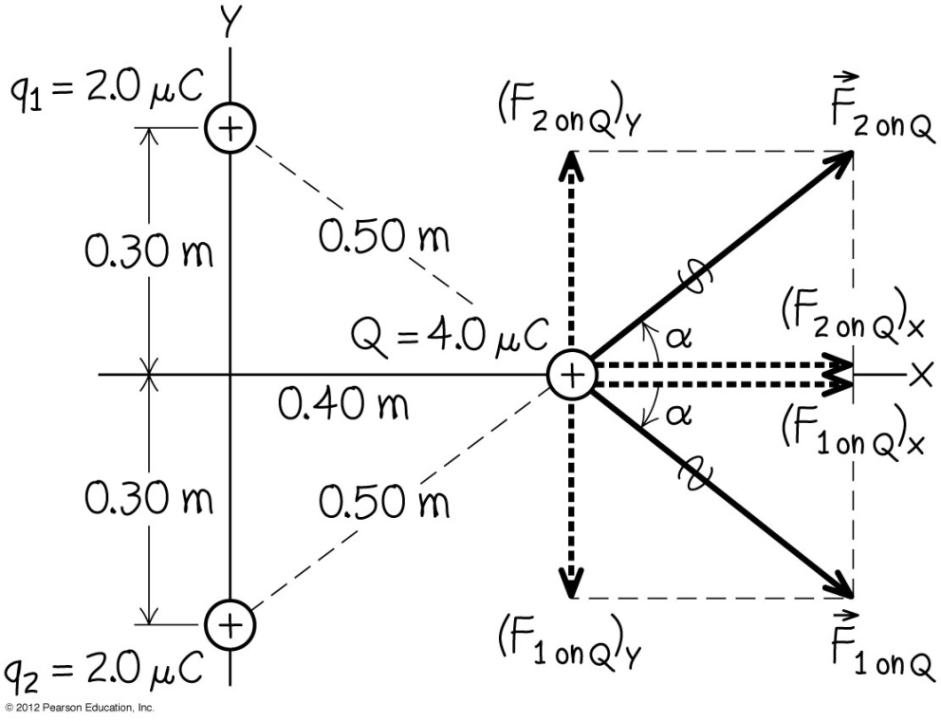
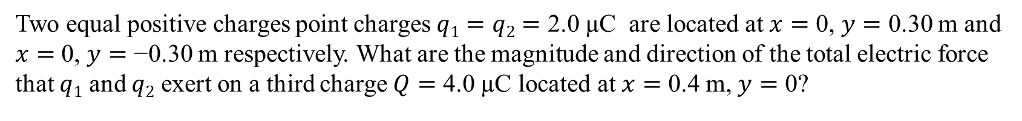
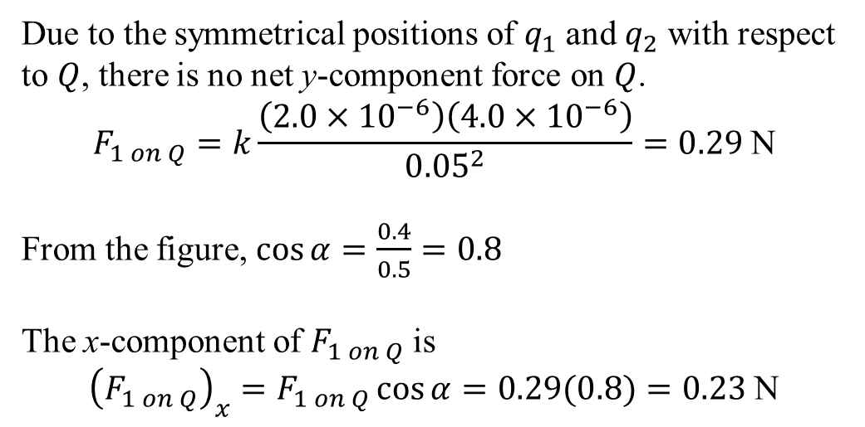
Example 4
Two equal positive charges point charges $q1=q2=$ 2.0 µC are located at $x=$ 0, $y=$ 0.30 m and $x=$ 0, $y=$ −0.30 m respectively. What are the magnitude and direction of the total electric force that $q1$ and $q2$ exert on a third charge $Q=$ 4.0 µC located at $x=$ 0.4 m, $y=$ 0?
Due to the symmetrical positions of $q_{1}$ and $q_{2}$ with respect to $Q$, there is no net y-component force on $Q$.
$$F_{1 on Q}=k\frac{\left(2.0×{10}^{−6}\right)\left(4.0×{10}^{−6}\right)}{{0.05}^{2}}=0.29 \text{N}$$
From the figure, $\cos{α}=\frac{0.4}{0.5}=0.8$
The x-component of $F_{1 on Q}$ is
$${\left(F_{1 on Q}\right)}_{x}=F_{1 on Q}\cos{α}=0.29(0.8)=0.23 \text{N}$$

Slide 14
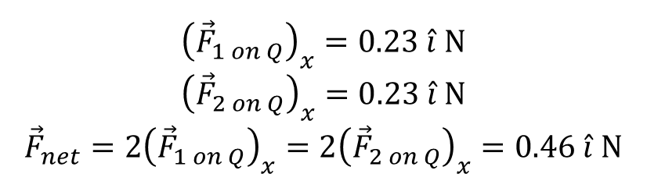
Example 4 - cont
Two equal positive charges point charges $q1=q2=$ 2.0 µC are located at $x=$ 0, $y=$ 0.30 m and $x=$ 0, $y=$ −0.30 m respectively. What are the magnitude and direction of the total electric force that $q1$ and $q2$ exert on a third charge $Q=$ 4.0 µC located at $x=$ 0.4 m, $y=$ 0?
$${\left({\vec{F}}_{1 on Q}\right)}_{x}=0.23 \hat{i} \text{N}$$
$${\left({\vec{F}}_{2 on Q}\right)}_{x}=0.23 \hat{i} \text{N}$$
$${\vec{F}}_{net}=2{\left({\vec{F}}_{1 on Q}\right)}_{x}=2{\left({\vec{F}}_{2 on Q}\right)}_{x}=0.46 \hat{i} \text{N}$$

Slide 15
End of pre-class slides

Slide 16
Electric field
An electric field is a region where an electric charge experiences an electric force.
The charge may be either stationary or moving.
The direction of electric field is defined as the direction of the electric force on a positive test charge.
Electric fields are represented by imaginary field lines.
The stronger the field, the denser the lines.

Slide 17
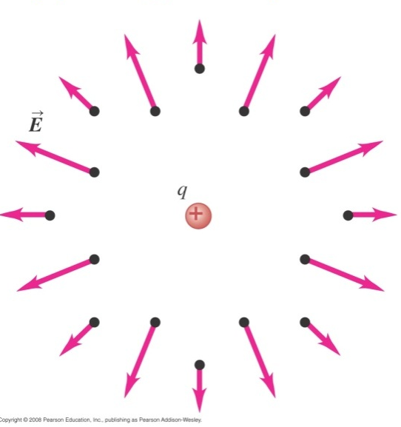
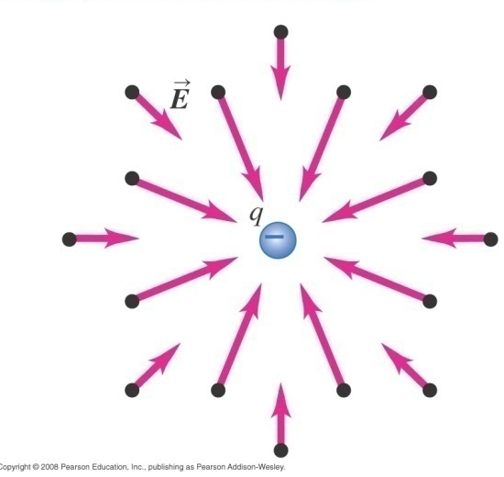
Electric field of point charges
For a single isolated positive point charge, the field lines are straight lines pointing away from the positive charge.
For a single isolated negative point charge, the field lines are straight lines pointing towards the negative charge.

Slide 18
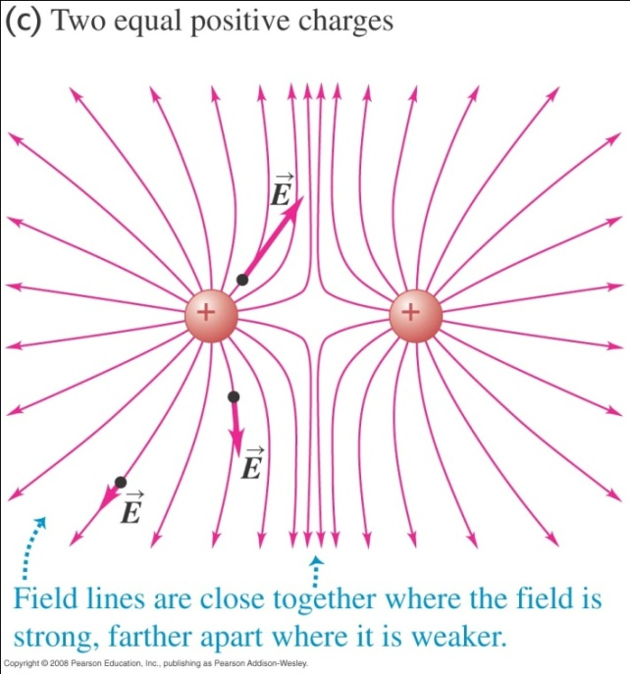
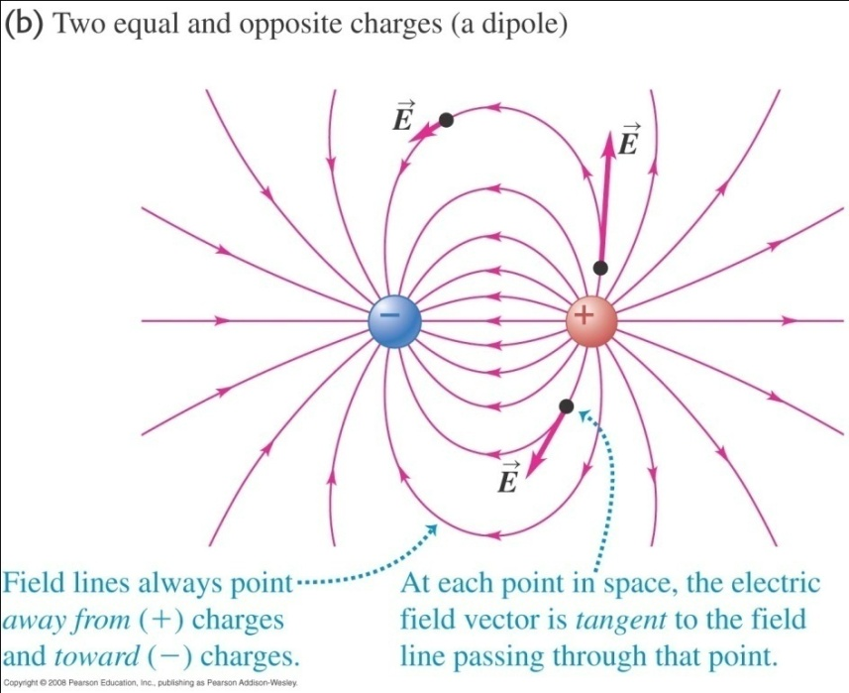
Electric field due to two point charges
The electric field of two point charges is the resultant of their individual fields.
The shapes of the field lines are such that the tangent to the curves at any point is the direction of the electric force on a positive charge at that point.
Direction of E is also direction of force on positive charge

Slide 19
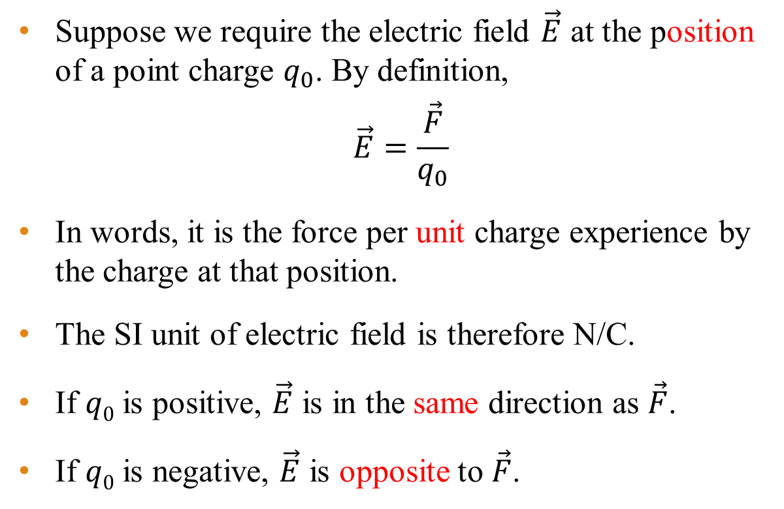
Mathematical definition of electric field
Suppose we require the electric field $\vec{E}$ at the position of a point charge $q_{0}$. By definition,
$$\vec{E}=\frac{\vec{F}}{q_{0}}$$
In words, it is the force per unit charge experience by the charge at that position.
The SI unit of electric field is therefore N/C.
If $q0$ is positive, $\vec{E}$ is in the same direction as $\vec{F}$.
If $q0$ is negative, $\vec{E}$ is opposite to $\vec{F}$.

Slide 20
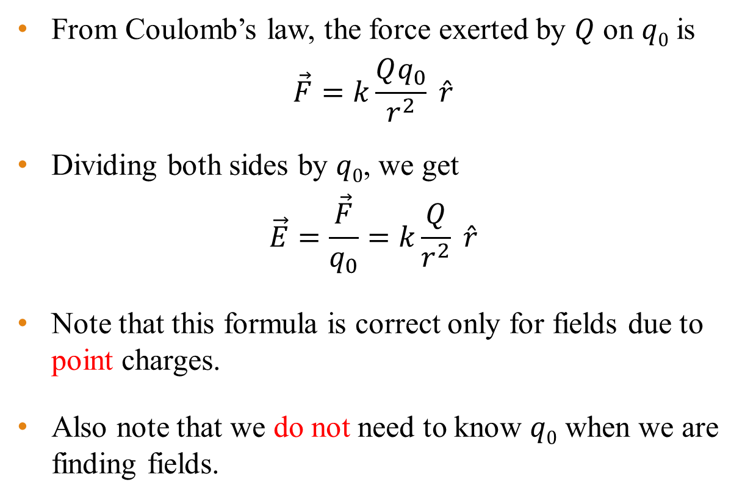
Electric field due to a point charge
From Coulomb’s law, the force exerted by $Q$ on $q0$ is
$$\vec{F}=k\frac{Qq_{0}}{r^{2}} \hat{r}$$
Dividing both sides by $q0$, we get
$$\vec{E}=\frac{\vec{F}}{q_{0}}=k\frac{Q}{r^{2}} \hat{r}$$
Note that this formula is correct only for fields due to point charges.
Also note that we do not need to know $q0$ when we are finding fields.

Slide 21


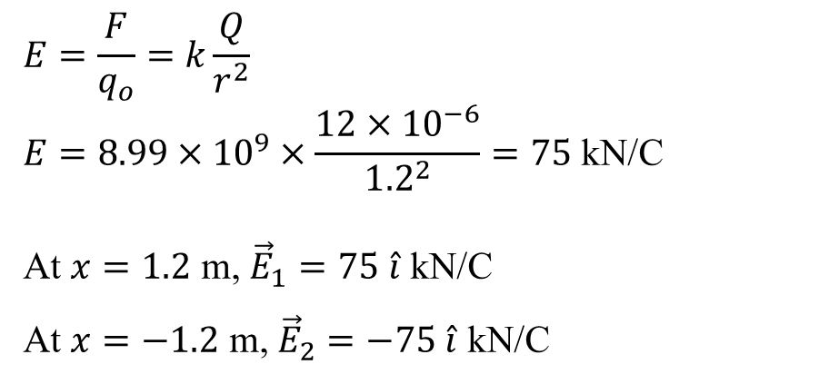
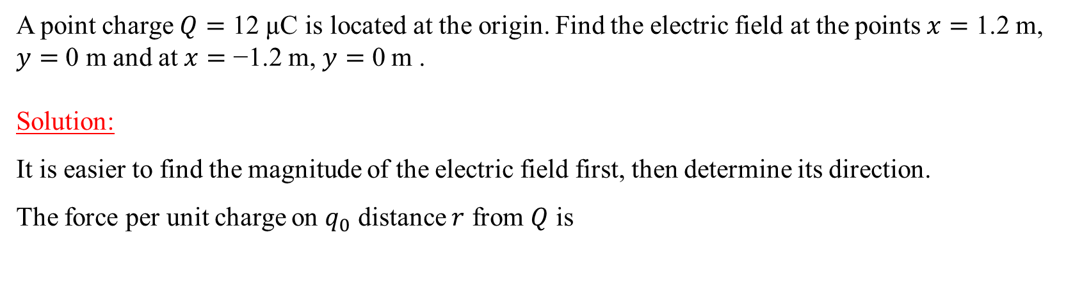
Example 5
A point charge $Q=$ 12 µC is located at the origin. Find the electric field at the points $x=$ 1.2 m, $y=$ 0 m and at $x=$ −1.2 m, $y=$ 0 m .
Solution:
It is easier to find the magnitude of the electric field first, then determine its direction.
The force per unit charge on $q_{0}$ distance $r$ from $Q$ is
$$E=\frac{F}{q_{o}}=k\frac{Q}{r^{2}}$$
$$E=8.99×{10}^{9}×\frac{12×{10}^{−6}}{{1.2}^{2}}=75 \text{kN}\text{/}\text{C}$$
At $x=1.2$ m, ${\vec{E}}_{1}=75 \hat{i}$ kN/C
At $x=−1.2$ m, ${\vec{E}}_{2}=−75 \hat{i}$ kN/C
$${\vec{E}}_{2}$$
$${\vec{E}}_{1}$$

Slide 22
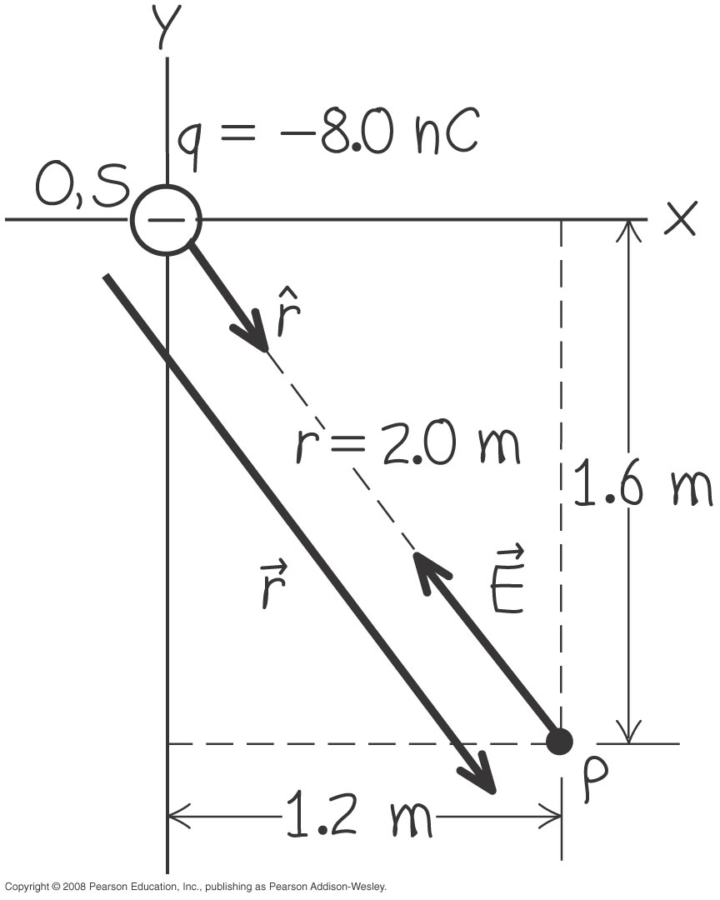

Example 6
A point charge $q=$ −8.0 nC is located at the origin. Find the electric field vector at the point $x=$ 1.2 m, $y=$ −1.6 m.
Notes:
E = (−11 N/C) i + (14N/C) j

Slide 23
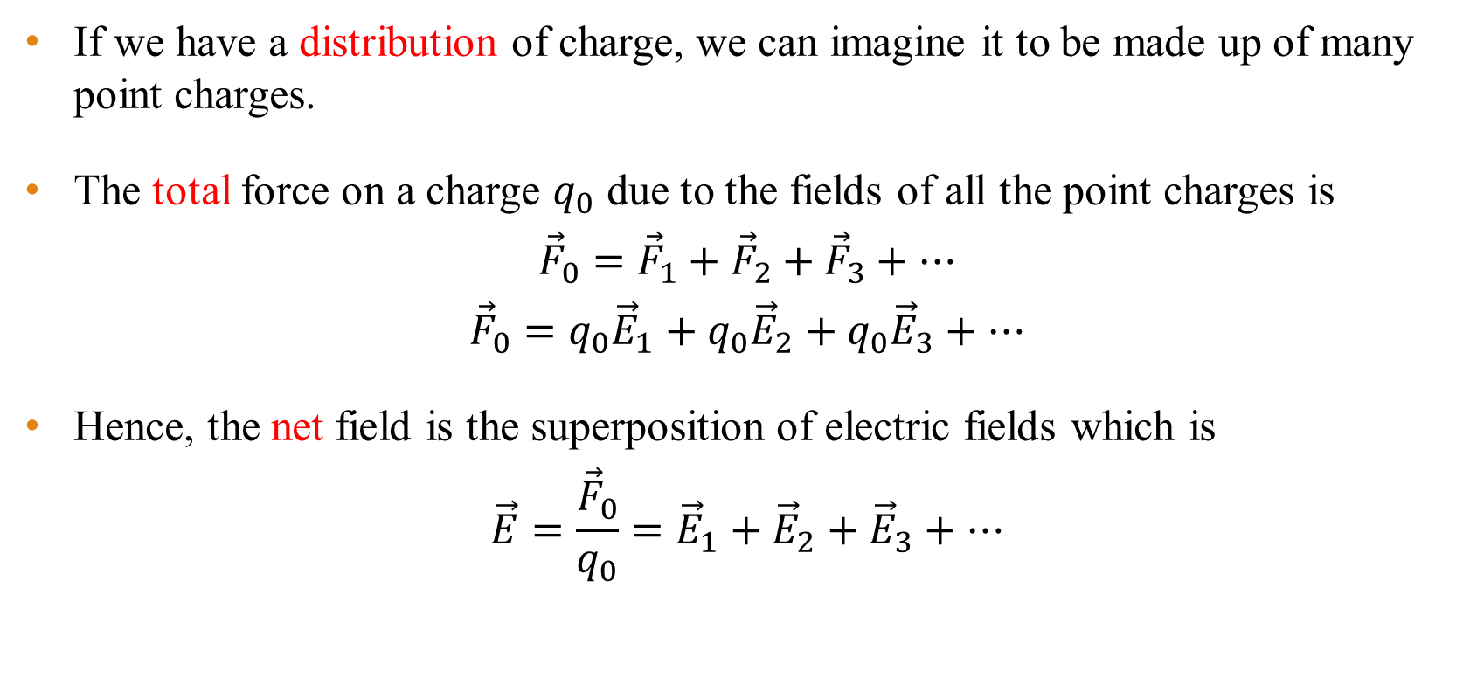
Superposition of electric fields
If we have a distribution of charge, we can imagine it to be made up of many point charges.
The total force on a charge $q_{0}$ due to the fields of all the point charges is
$${\vec{F}}_{0}={\vec{F}}_{1}+{\vec{F}}_{2}+{\vec{F}}_{3}+…$$
$${\vec{F}}_{0}=q_{0}{\vec{E}}_{1}+q_{0}{\vec{E}}_{2}+q_{0}{\vec{E}}_{3}+…$$
Hence, the net field is the superposition of electric fields which is
$$\vec{E}=\frac{{\vec{F}}_{0}}{q_{0}}={\vec{E}}_{1}+{\vec{E}}_{2}+{\vec{E}}_{3}+…$$

Slide 24
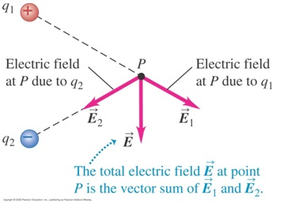
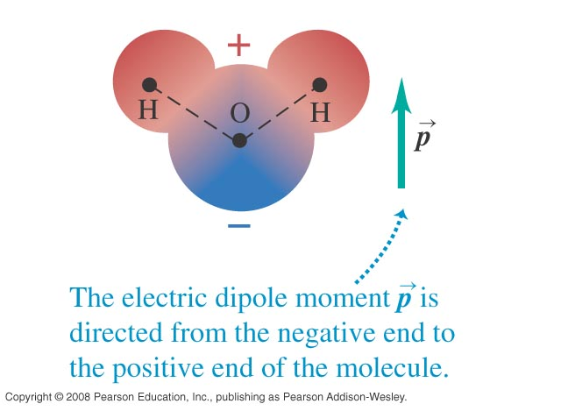
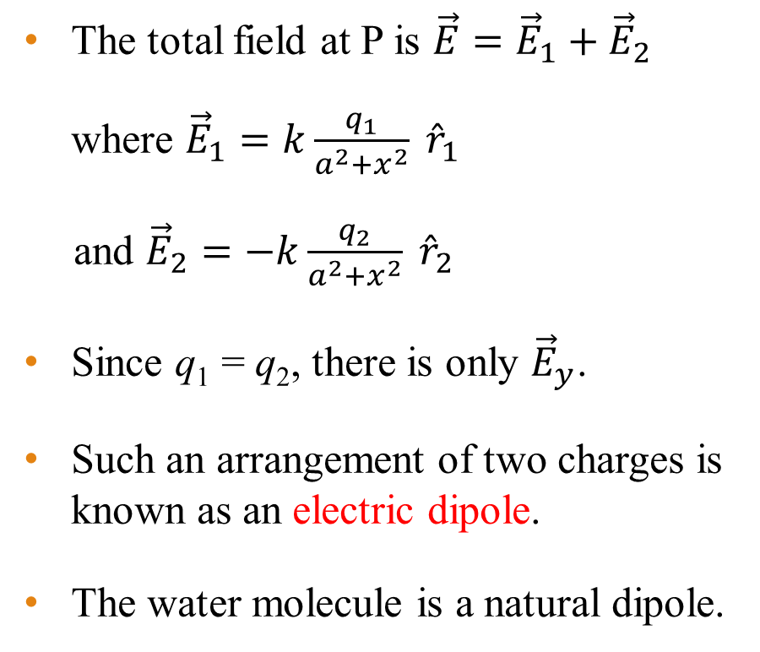
Field due to two equal point charges of opposite signs
x
The total field at P is $\vec{E}={\vec{E}}_{1}+{\vec{E}}_{2}$
where ${\vec{E}}_{1}=k\frac{q_{1}}{a^{2}+x^{2}} {\hat{r}}_{1}$
and ${\vec{E}}_{2}=−k\frac{q_{2}}{a^{2}+x^{2}} {\hat{r}}_{2}$
Since q₁ = q₂, there is only ${\vec{E}}_{y}$.
Such an arrangement of two charges is known as an electric dipole.
The water molecule is a natural dipole.
r₁
2a
r₂

Slide 25
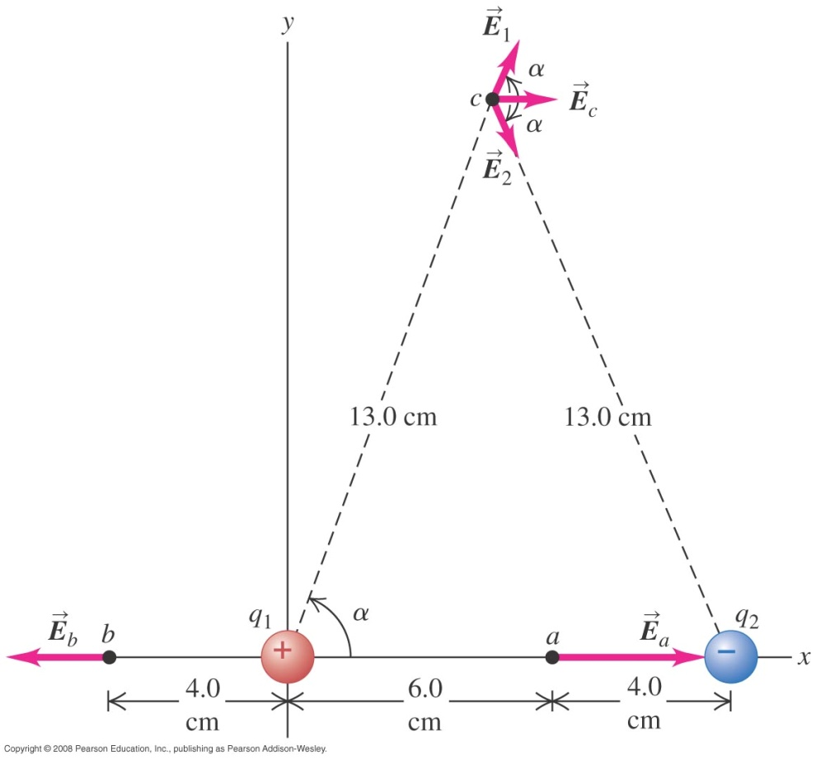

Example 7
Point charges, $q1=$ +12 nC and $q2=$ −12 nC, placed 10 cm apart (see figure). Compute the total electric field at point a, b and c.
Notes:
(a) E_{a} = (9.8 × 10⁴ N/C) i
(b) E_{b} = (−6.2 × 10⁴ N/C) i
(c) E_{c} = (4.9 × 10³ N/C) i

Slide 26
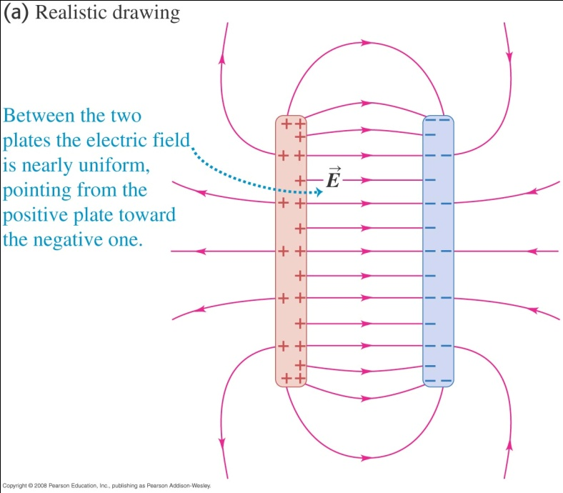
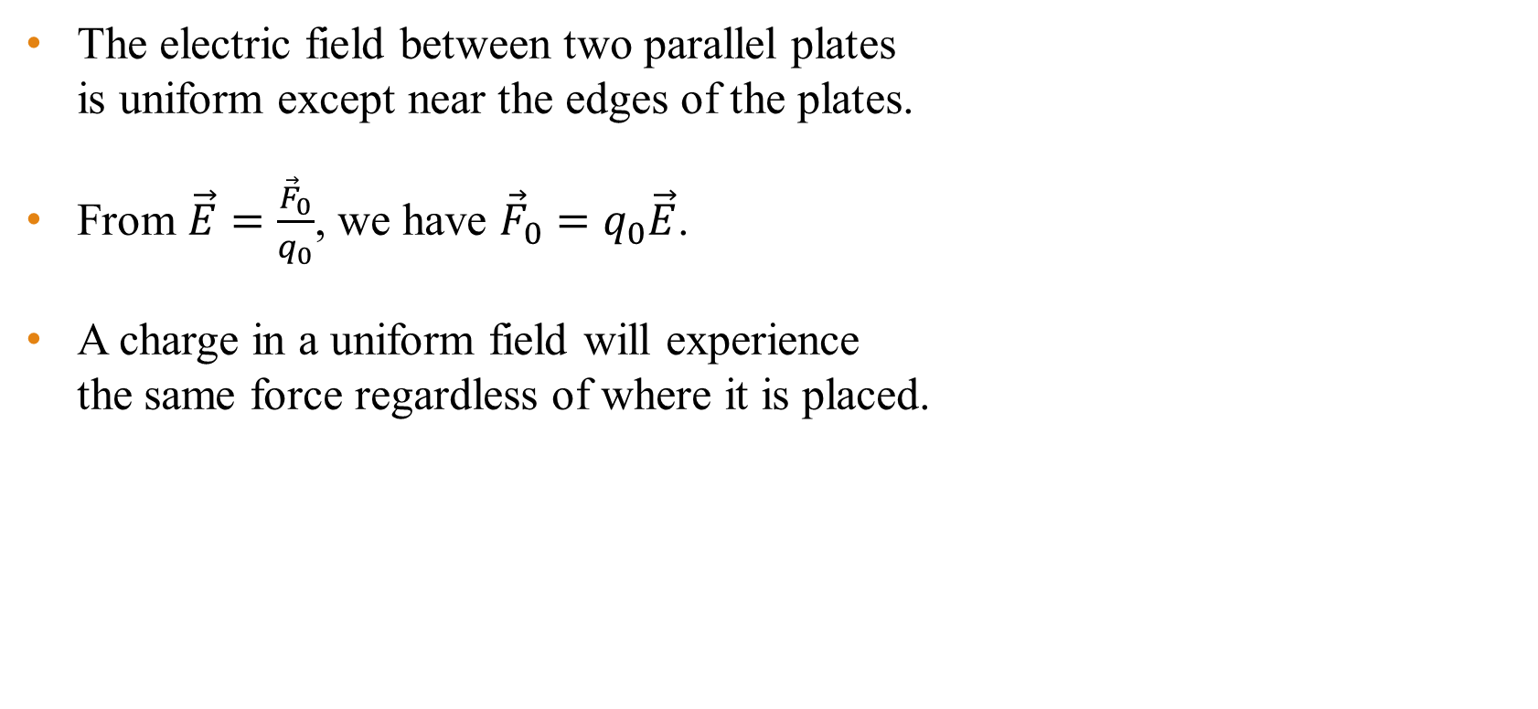
Electric field between two parallel plates
The electric field between two parallel plates is uniform except near the edges of the plates.
From $\vec{E}=\frac{{\vec{F}}_{0}}{q_{0}}$, we have ${\vec{F}}_{0}=q_{0}\vec{E}$.
A charge in a uniform field will experience the same force regardless of where it is placed.

Slide 27
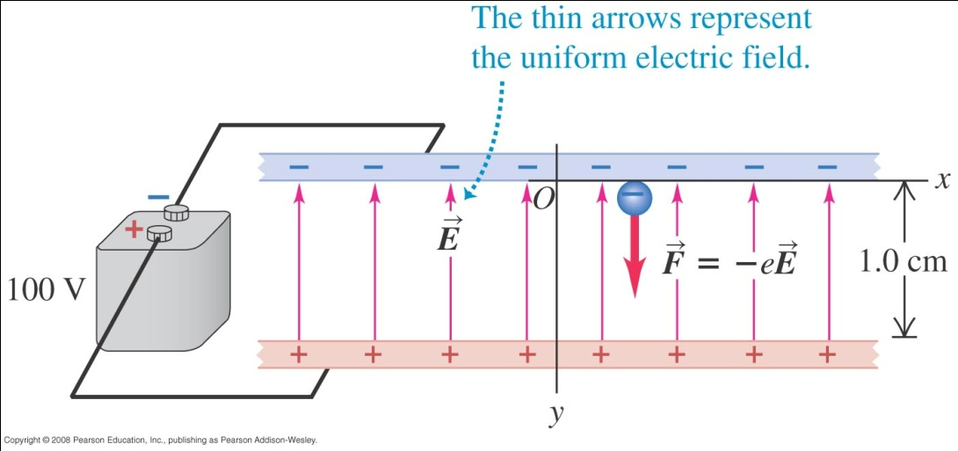

Example 8
The diagram shows a uniform electric field of magnitude $E=$ 1.00 × 10⁴ N/C. Mass of an electron is 9.11 × 10⁻³¹ kg. If an electron is released from rest at the upper plate,
a) What is its acceleration?
b) What speed and kinetic energy does the electron acquire travelling 1.0 cm to the lower plate?
c) How much time is required for it to reach the lower plate?
Notes:
a = −1.76 × 10¹⁵ m/s²
v = 5.9 × 10⁶ m/s, KE = 1.6 × 10⁻¹⁷ J
t = 3.4 × 10⁻⁹ s

Slide 28
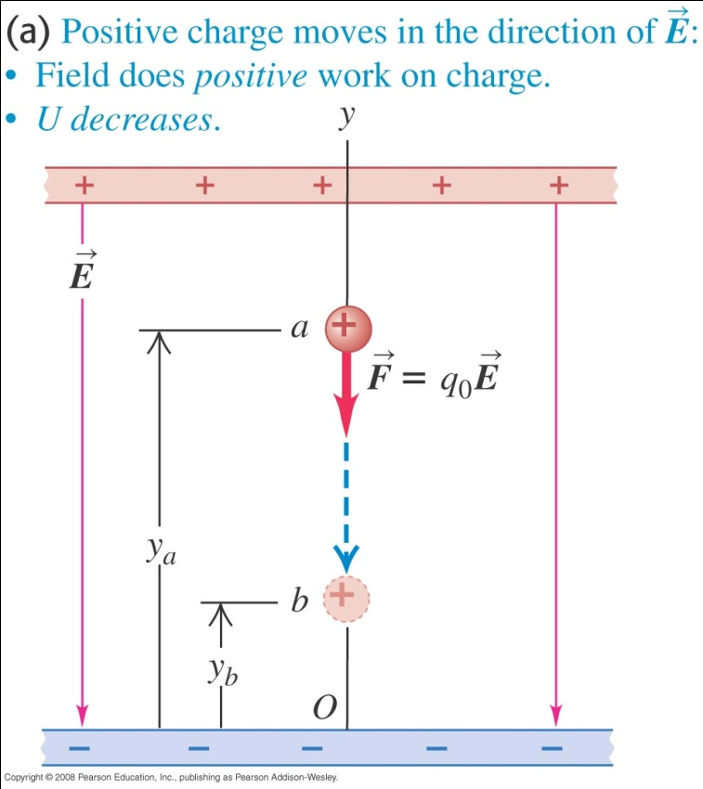
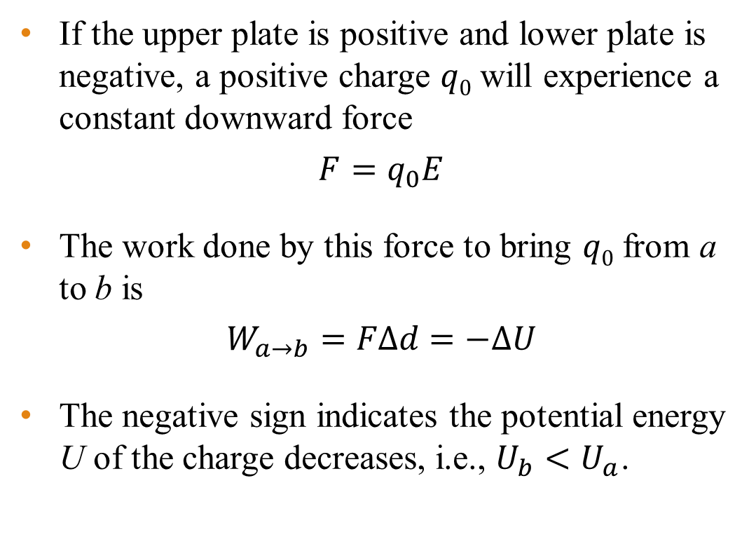
Electric potential energy – uniform field
If the upper plate is positive and lower plate is negative, a positive charge $q0$ will experience a constant downward force
$$F=q_{0}E$$
The work done by this force to bring $q0$ from a to b is
$$W_{a→b}=FΔd=−ΔU$$
The negative sign indicates the potential energy U of the charge decreases, i.e., $U_{b}<U_{a}$.

Slide 29
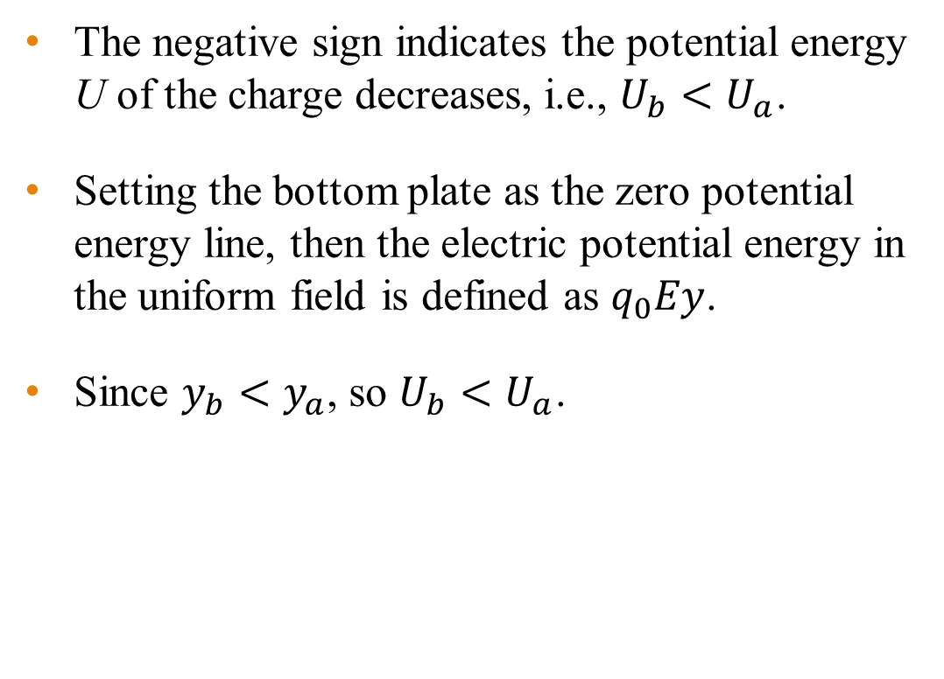
Electric potential energy – uniform field
The negative sign indicates the potential energy U of the charge decreases, i.e., $U_{b}<U_{a}$.
Setting the bottom plate as the zero potential energy line, then the electric potential energy in the uniform field is defined as $q_{0}Ey$.
Since $y_{b}<y_{a}$, so $U_{b}<U_{a}$.

Slide 30
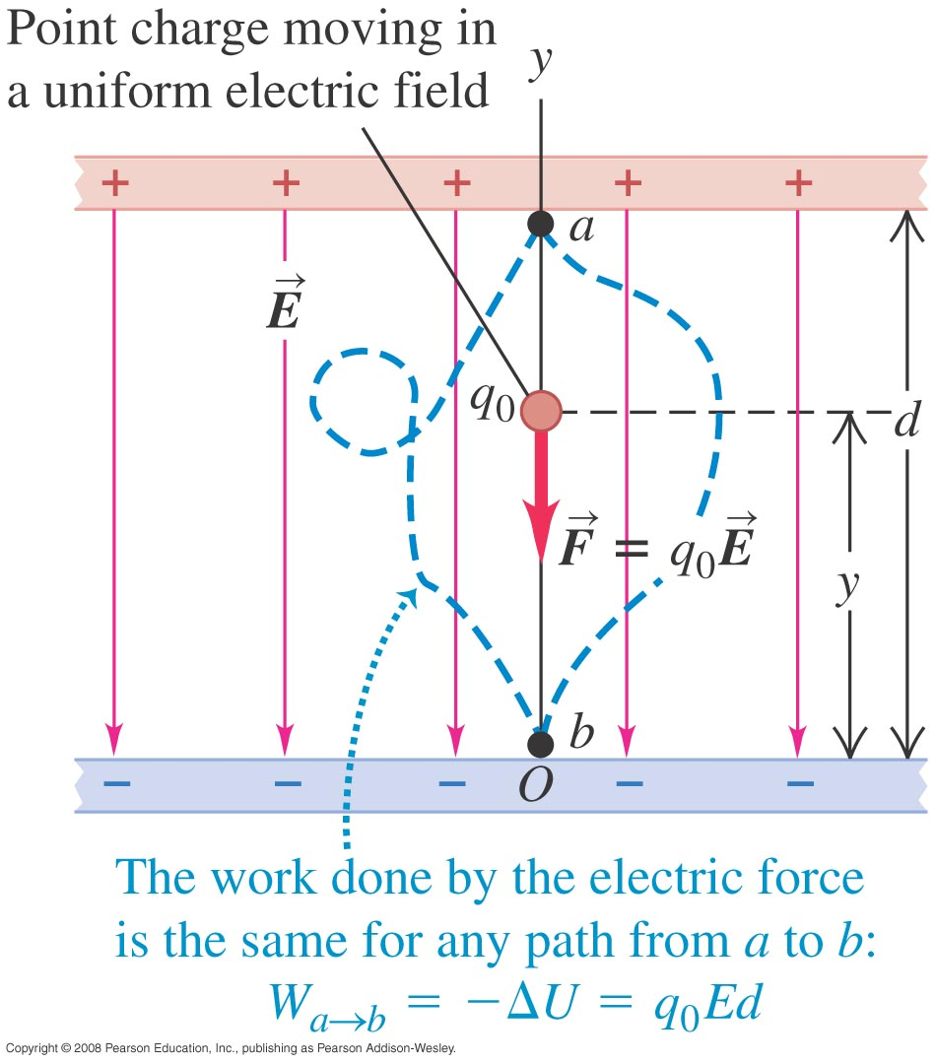
Electric potential energy – uniform field
The electrostatic force is a conservative force.
The work done by the electric force is the same for any path from a to b.
The work done by the electric force is independent of path.
Notes:
When gravity does work to bring an object down, the potential energy decreases.

Slide 31
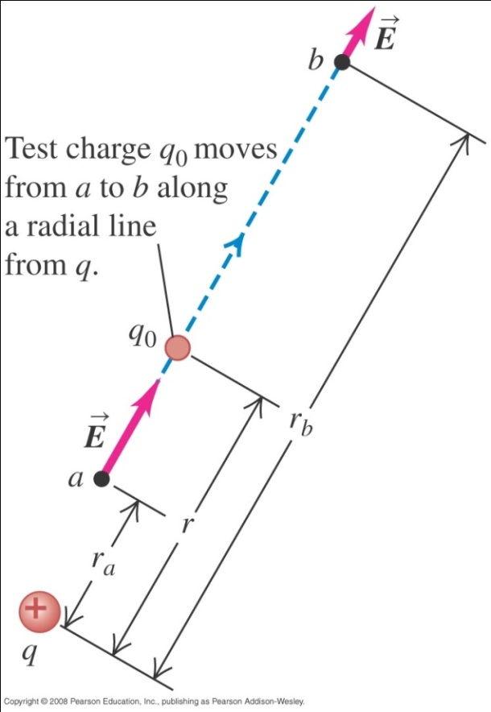
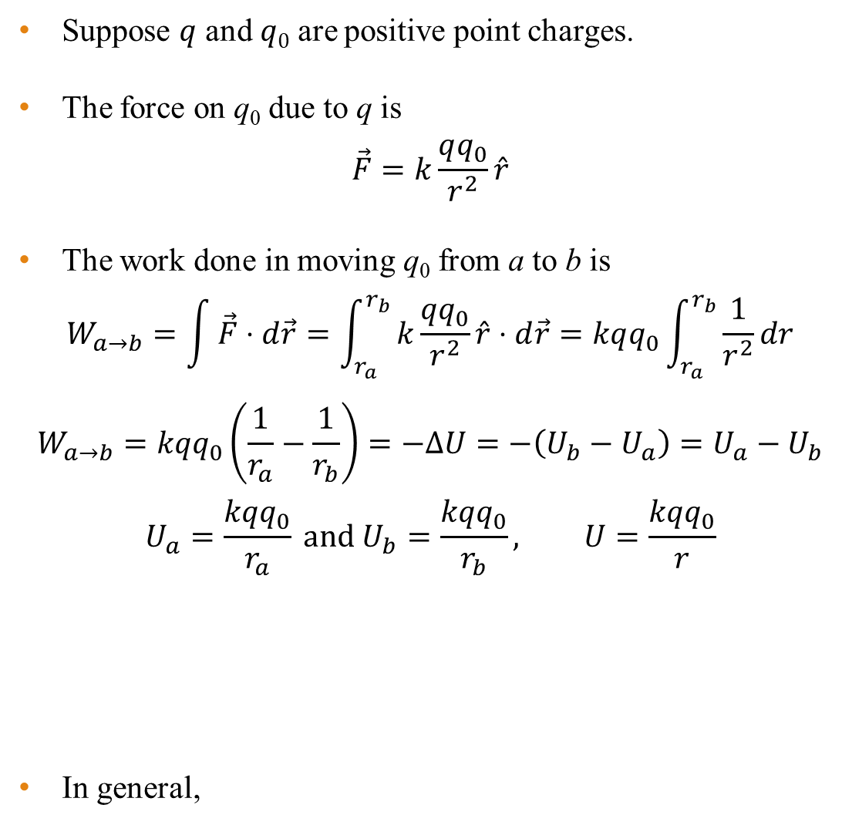
Electric potential energy
Suppose $q$ and $q0$ are positive point charges.
The force on q₀ due to q is
$$\vec{F}=k\frac{qq_{0}}{r^{2}}\hat{r}$$
The work done in moving q₀ from a to b is
$$W_{a→b}=\int{\vec{F}⋅d\vec{r}}=\int_{r_{a}}^{r_{b}}{k\frac{qq_{0}}{r^{2}}\hat{r}⋅d\vec{r}}=kqq_{0}\int_{r_{a}}^{r_{b}}{\frac{1}{r^{2}}dr}$$
$$W_{a→b}=kqq_{0}\left(\frac{1}{r_{a}}−\frac{1}{r_{b}}\right)=−ΔU=−\left(U_{b}−U_{a}\right)=U_{a}−U_{b}$$
$$U_{a}=\frac{kqq_{0}}{r_{a}} \text{and} U_{b}=\frac{kqq_{0}}{r_{b}}, U=\frac{kqq_{0}}{r}$$
In general,

Slide 32
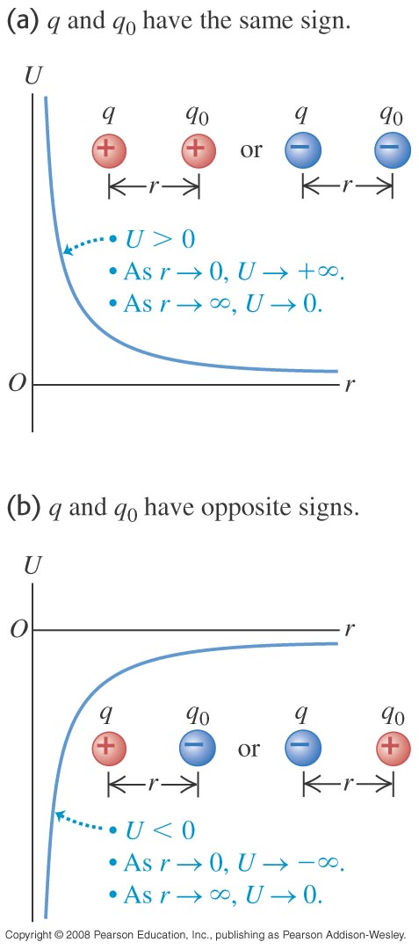
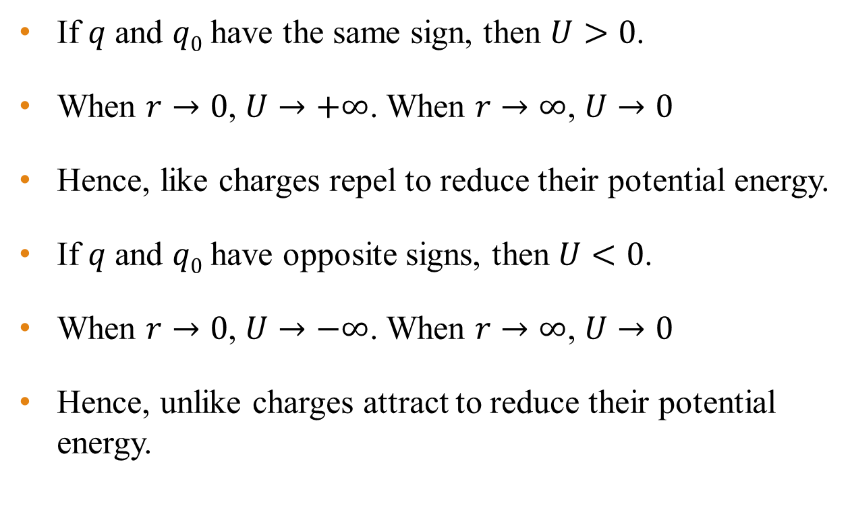
Electric potential energy
If $q$ and $q0$ have the same sign, then $U>0$.
When $r→0$, $U→+∞$. When $r→∞$, $U→0$
Hence, like charges repel to reduce their potential energy.
If $q$ and $q0$ have opposite signs, then $U<0$.
When $r→0$, $U→−∞$. When $r→∞$, $U→0$
Hence, unlike charges attract to reduce their potential energy.

Slide 33
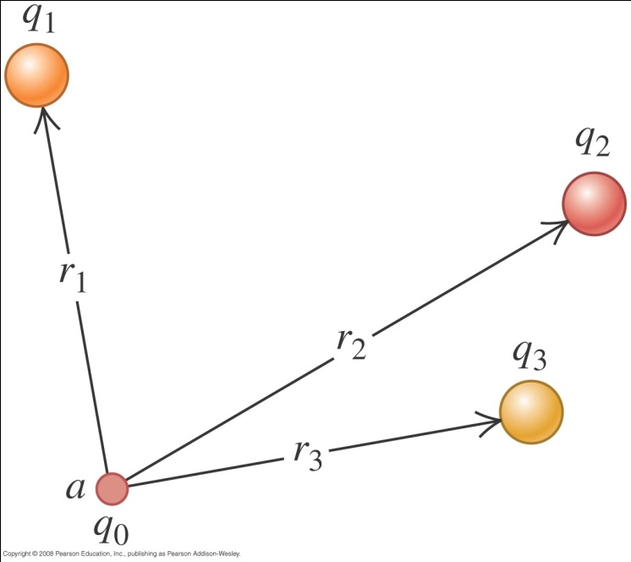
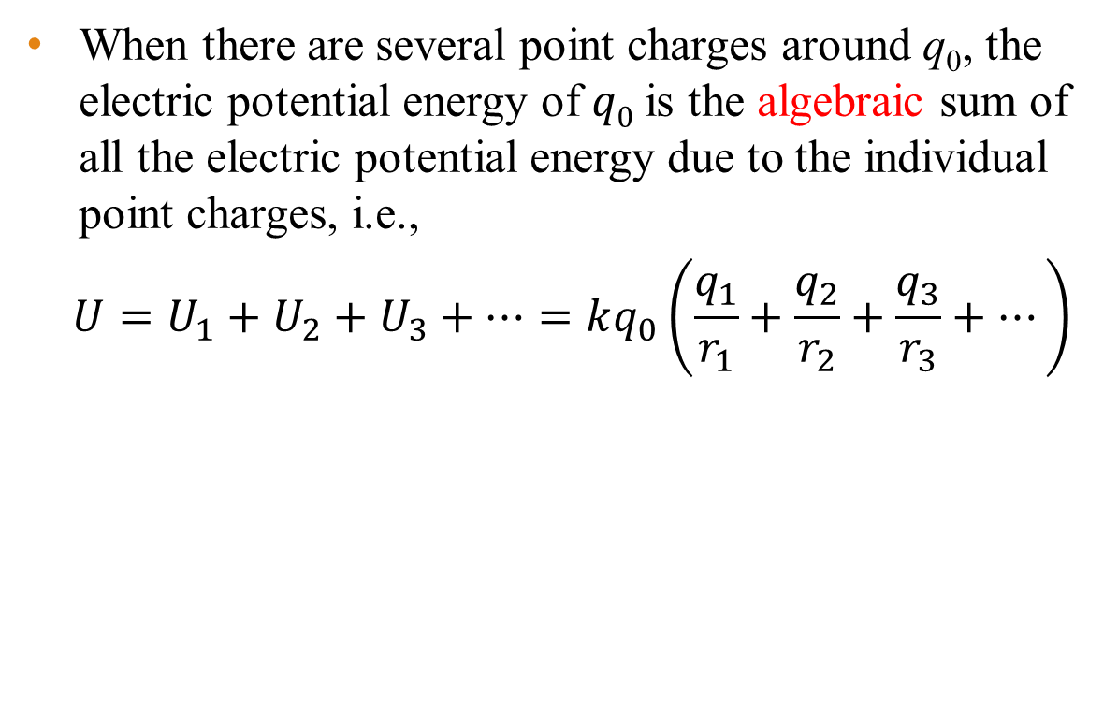
Electric potential energy of several point charges
When there are several point charges around q₀, the electric potential energy of $q0$ is the algebraic sum of all the electric potential energy due to the individual point charges, i.e.,
$$U=U_{1}+U_{2}+U_{3}+…=kq_{0}\left(\frac{q_{1}}{r_{1}}+\frac{q_{2}}{r_{2}}+\frac{q_{3}}{r_{3}}+…\right)$$

Slide 34

Example 9
The diagram shows a positive charge $Q=$ 1.0 µC at the origin. Find the electric potential energy U of q if a) $q=$ 1.0 µC and b) if $q=$ –1.0 µC.
Solution:
Using $U=\frac{kQq}{r}$,
$$\left(a\right) U=\frac{kQq}{r}=8.99×{10}^{9}\frac{{\left(1.0×{10}^{−6}\right)}^{2}}{1.2×{10}^{−3}}=7.49 \text{J}$$
$$\left(b\right) U=\frac{kQq}{r}=−8.99×{10}^{9}\frac{{\left(1.0×{10}^{−6}\right)}^{2}}{1.2×{10}^{−3}}=−7.49 \text{J}$$

Slide 35

Electric potential
The electric potential (V) at $q0$ is defined as the electric potential energy (U) per unit charge $q0$ at that point, i.e.
$$V=\frac{U}{q_{0}}$$
The SI unit of electric potential is joule per coulomb (J/C) or volt (V).
Since the potential energy at any point r from a point charge q is $U=\frac{kqq_{0}}{r}$, the potential V at that point is $V=\frac{U}{q_{0}}=\frac{kq}{r}$.
Unlike electric potential energy, we need not know $q0$ if we are calculating the electric potential.

Slide 36


Example 10
An electric dipole consists of two point charges, $q1=$ +12 nC and $q2=$ −12 nC, placed 10 cm apart. Compute the potentials at point a, b and c by adding potentials due to either charge.
Notes:
V_{a} = −900 V, V_{b} = 1930 V, V_{c} = 0 V

Slide 37

Electric potential – uniform field
From the diagram at right, we have $\vec{F}=−q_{0}E\hat{y}$.
The electric potential energy is $U=q_{0}Ey$.
We can therefore write $F=−\frac{ΔU}{Δy}$.
Since $F=q_{0}E$, dividing both sides by $q0$, we have
$$E=\frac{F}{q_{0}}=−\frac{ΔU}{q_{0}Δy}=−\frac{ΔV}{Δy}$$
The electric field is therefore also equal to the negative of the electric potential gradient.
Another unit of electric field is V/m.

Slide 38

Example 11
A proton of charge 1.60 × 10⁻¹⁹ C, moves in a straight line from point a to point b inside a linear accelerator, a total distance $d=$ 0.50 m. The electric field is uniform along this line, with magnitude $E=$ 1.5 × 10⁷ V/m in the direction from a to b. Determine
a) the force on the proton
b) the work done on it by the field
c) the potential difference $V_{a}−V_{b}$
Notes:
F = 2.4 × 10⁻¹² N
W = 1.2 × 10⁻¹² J or 7.5 MeV
V_{a} – V_{b} = 7.5 MV

Slide 39

The electron-volt (eV) as a unit of energy
From $V=\frac{U}{q_{0}}$, we have $U=q0V$
If q₀ = e = 1.6 × 10⁻¹⁹ coulomb and V is 1 volt, then
$U=q0V=eV=$ 1.6 × 10⁻¹⁹ C × 1 V $=$ 1.6 × 10⁻¹⁹ J.
By definition, this amount of energy is called 1 electron-volt (eV).
Hence 1 eV = 1.6 × 10⁻¹⁹ J.
The unit of eV is widely used in atomic physics.

Slide 40


Example 12
An electric potential difference of 2000 V is applied to a pair of plates that is separated by 1 cm. If a particle of charge 6.40×10⁻¹⁹ C is released from the upper plate
a) What is the electric field (that is uniform) in the region between the plates?
b) If the mass of the particle is 1.92×10⁻¹⁶ kg, what is the speed of the particle as it reaches the bottom plate?
Solution:
$$\left(\text{a}\right) E=\frac{V}{d}=\frac{2000}{0.01}=200000 \text{V}\text{/}\text{m}$$
(b) Using work-energy theorem,
$$W=Fd=qEd=qV=\frac{1}{2}mv^{2}$$
$$v=\sqrt{\frac{2qV}{m}}=\sqrt{\frac{2×6.40×{10}^{−19}×2000}{1.92×{10}^{−16}}}=3.7 \text{m}\text{/}\text{s}$$

Slide 41


Electric field from potential of point charge
From the definition of work and potential,
$$W_{a→b}=\int_{a}^{b}{\vec{F}⋅d\vec{l}}=\int_{a}^{b}{q_{0}\vec{E}⋅d\vec{l}}=−ΔU=−q_{0}ΔV$$
$$ΔV=V_{b}−V_{a}=−\int_{a}^{b}{\vec{E}⋅d\vec{l}}$$
For a point charge, $\vec{E}=\frac{q}{4πε_{0}r^{2}}\hat{r}$.
Since the field is radial, $d\vec{l}=d\vec{r}$, the integral becomes
$$V_{b}−V_{a}=−\int_{a}^{b}{\frac{q}{4πε_{0}r^{2}}dr}=\frac{q}{4πε_{0}}\left(\frac{1}{b}−\frac{1}{a}\right)$$

Slide 42
Optional Slides

Slide 43

Electric field due to a ring of charge
From symmetry, at P the electric field E_{y} = 0.
The electric field dE_{x} at P due to a small segment of the charged ring is
Hence

Slide 44

Electric field due to a charged line segment
From symmetry, at P the electric field E_{y} = 0.
The electric field dE_{x} at point P due to a small segment of a line segment ring is
Hence

Slide 45
Millikan oil drop experiment
A negatively charged oil drop is held stationary between two charged plates.
qE = mg, or q = mg/E
If we know the mass of the oil drop, and the electric field, we can calculate the charge on the oil drop!
+ + + + + + + +
qE
-
mg
- - - - - - - -

Slide 46
Example 11
In a particular Millikan oil drop apparatus, the plates are 2 cm apart. An electric field strength field of 5 × 10⁴ N/C caused an oil drop to become stationary. The oil used has a density of 885 kgm⁻³.
a) What is the potential difference that is applied to the plates?
b) The oil drop has a volume of 7.24 × 10⁻¹⁸ m³. What is the charge on the oil drop?
c) If the oil drop is negatively charged, how many extra electrons does it have?

Slide 47

Electric flux
Electric flux, Φ is defined as
where φ is the angle between the normal to the surface and .
If is non-uniform,

Slide 48
Gauss law
Gauss’ law states that “The net electric flux coming out of a closed surface is proportional to the net electric charge inside the surface.”
Mathematically,
The constant of proportionality is ε or ε₀ if the charge is in a vacuum.
Hence
If the charge is in vacuum, then

Slide 49

Coulomb’s law from Gauss law
Suppose a positive point charge, q, is at the center of a sphere radius r.
This formula is the same as the one derived using Coulomb’s law.

Slide 50
End of chapter

